Slide 1


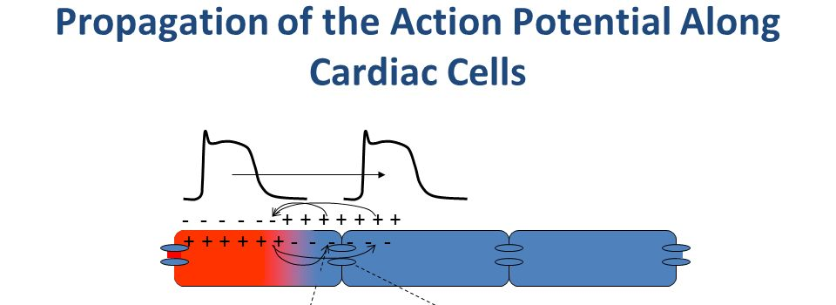
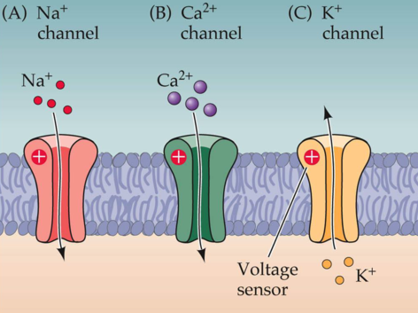
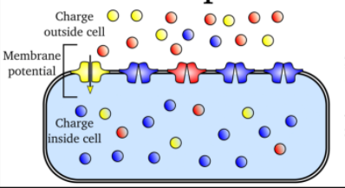
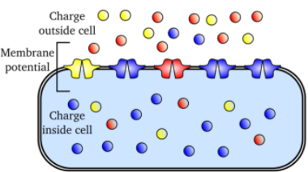
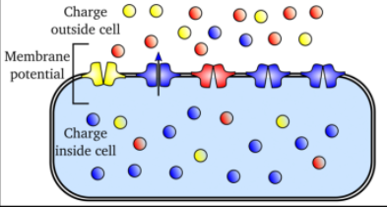
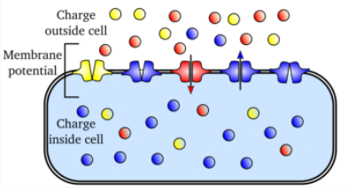
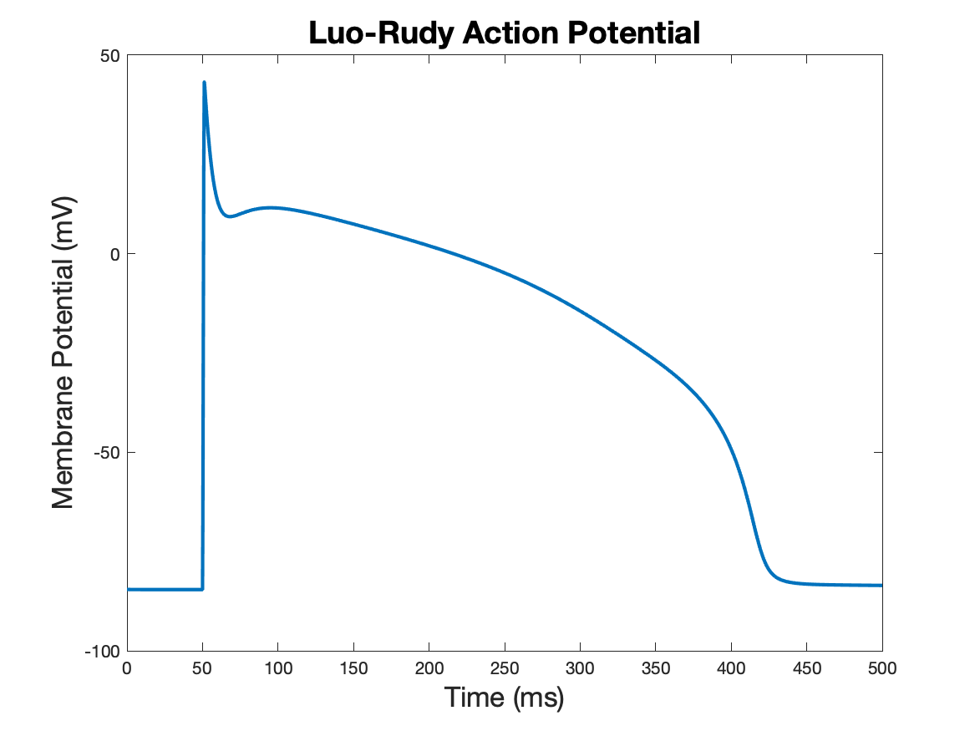
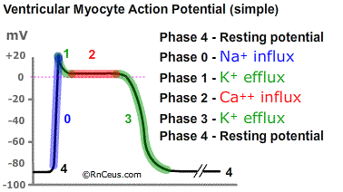
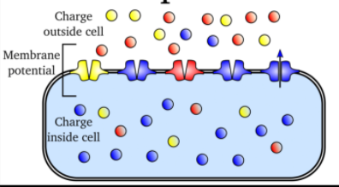

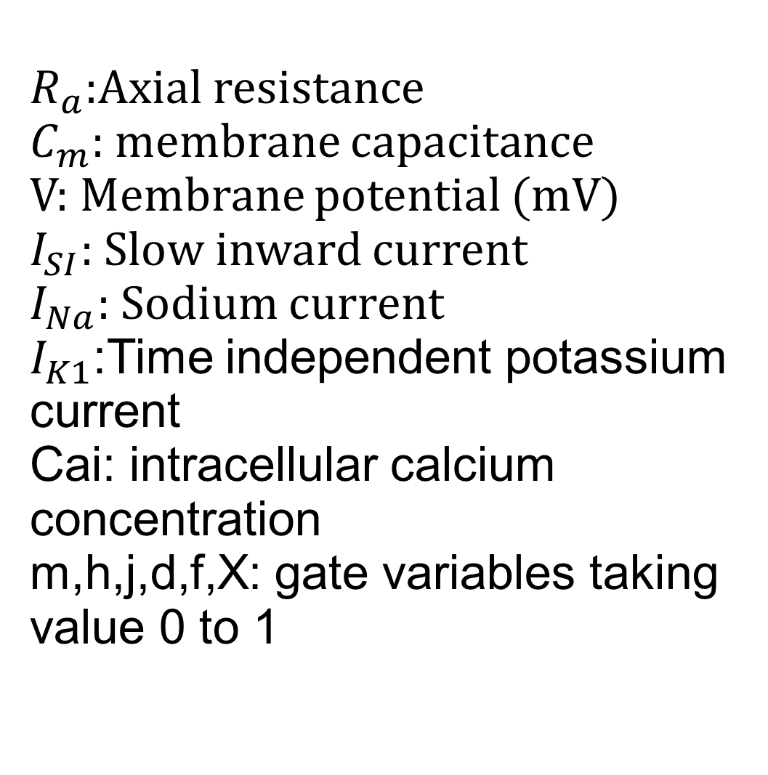
Action Potential and Luo-Rudy Model
Sule Chhatra, Scott Moon, Corey Zhang
Department of Mathematics, West Chester University of Pennsylvania
Abstract
Action Potential is a brief reversal of polarity of cell membrane produced by voltage gated ion channels (Sodium, Potassium, and Calcium), which play a central role in cell-to-cell communication. In the Luo-Rudy 1991 model, action potential propagation in excitable tissue is modeled by a system of differential equations which can only be solved numerically due to the complexity of the model itself. To this end, a finite difference method is developed and implemented in MATLAB to solve the Luo-Rudy model. Numerical results will be presented as well to demonstrate the accuracy of the obtained results.
Action Potential
Propagation
Voltage-gated ion channels
Phase 0: Depolarization
At threshold, voltage-gated Sodium channels are activated. positive charge enters the cell
$\frac{∂g}{∂t}=α_{g}\left(V\right)\left(1−g\right)−β_{g}\left(V\right)g$, for $g=m,h,j,d,f,X$
$$\frac{1}{R_{a}}\frac{∂^{2}v}{∂x^{2}}=C_{m}\frac{∂v}{∂t}+I_{ion}\left(V,t\right)+I_{stim}(t)$$
Phase 1: Fast-Repolarization
Phase 4: Rest
Mathematical Model
$$\frac{1}{R_{a}}\frac{∂^{2}v}{∂x^{2}}=C_{m}\frac{∂v}{∂t}+I_{ion}\left(V,t\right)+I_{stim}(t)$$
$R_{a}$:Axial resistance
$C_{m}$: membrane capacitance
V: Membrane potential (mV)
$I_{SI}$: Slow inward current
$I_{Na}$: Sodium current
$I_{K1}$:Time independent potassium current
Cai: intracellular calcium concentration
m,h,j,d,f,X: gate variables taking value 0 to 1
$\frac{∂g}{∂t}=α_{g}\left(V\right)\left(1−g\right)−β_{g}\left(V\right)g$, for $g=m,h,j,d,f,X$
$$E_{si}=7.7−13.0287∗ln(Cai)$$
In the resting state. There are more positive potassium ions (K⁺) inside the cell than outside; there are more positive sodium ions (N⁺) and Calcium ions (Ca⁺) outside the cell than inside.
Phase 2: Plateau
$\frac{d(Cai)}{dt}=−{10}^{−4}×$ $I_{SI}+0.07({10}^{−4}−Cai)$
$$I_{SI}=0.09∗d∗f∗(V−E_{si})$$
$$I_{ion}\left(V,t\right)=I_{Na}\left(V\right)+I_{SI}\left(V\right)+I_{K1(T)}\left(V\right)$$
Numerical Solution
We are still work-ing on this section
Phase 3: Repolarization
Bibliography
CH Luo, Y. R. (1991). A model of ventricular cardiac action potential. Circulation Research.
Li, C. (2011). A TIME-AND-SPACE PARALLELIZED. Knoxville: University of Tennessee.
Figure
https://www.rnceus.com/ekg/ekgphys.html
Figures
:http://physicsoftheheart.com/learning.html

